Slide 1
Fundamentals of Reinforcement Learning
Explaining theory through practice.
Doing practice in Python!

Slide 2
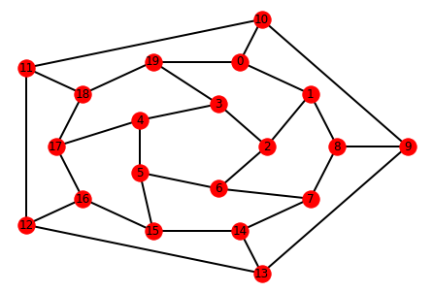
Environment

Slide 3

Agent

Slide 4
State

Slide 5
Action

Slide 6
Reward

Slide 7
Goal

Slide 8
Policy

Slide 9
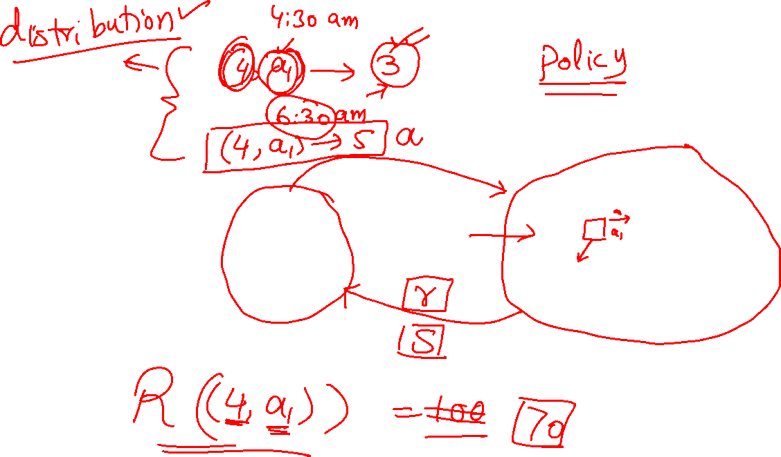
Summary

Slide 10
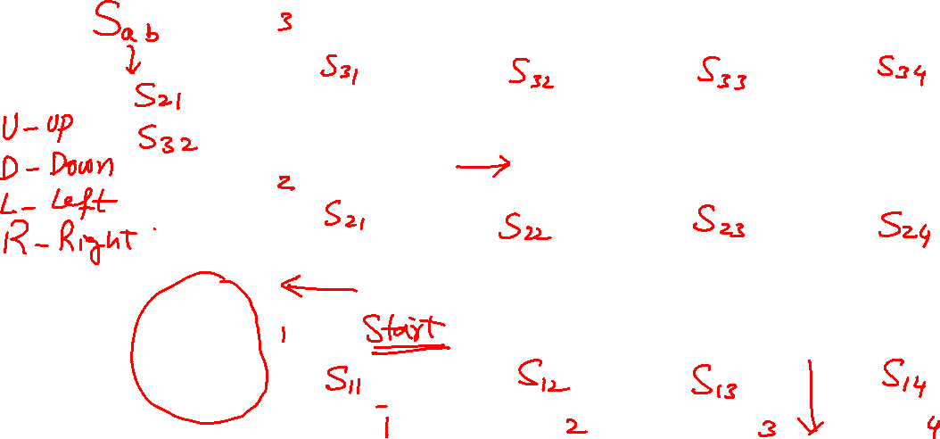
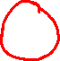
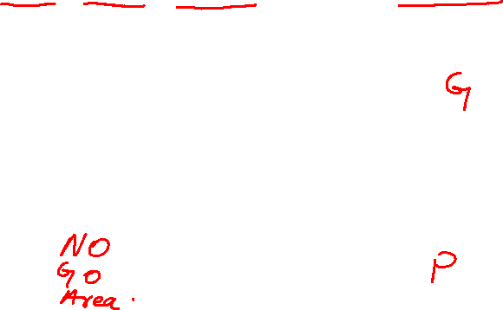
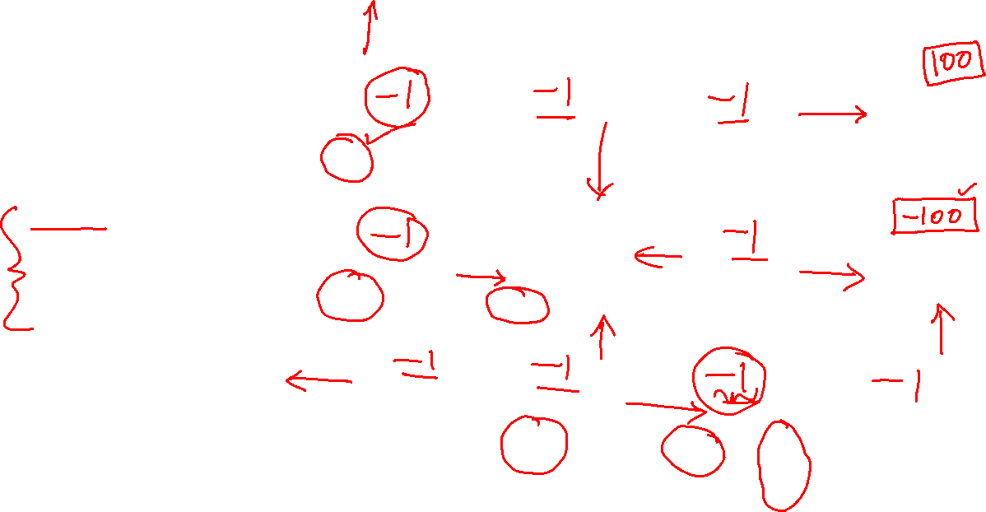
Example Grid World
Example Courtesy: Professor Charles Isbell & Professor Michael Littman

Slide 11
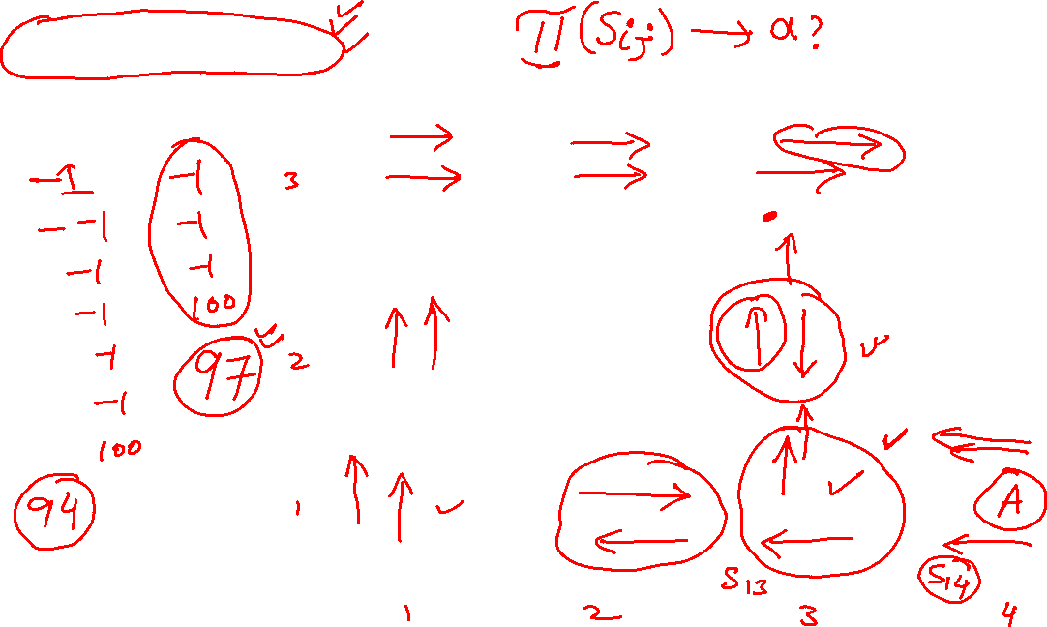
Deterministic Grid World

Slide 12
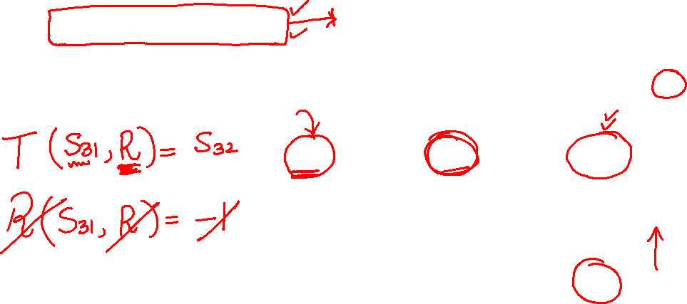
Deterministic Grid World

Slide 13
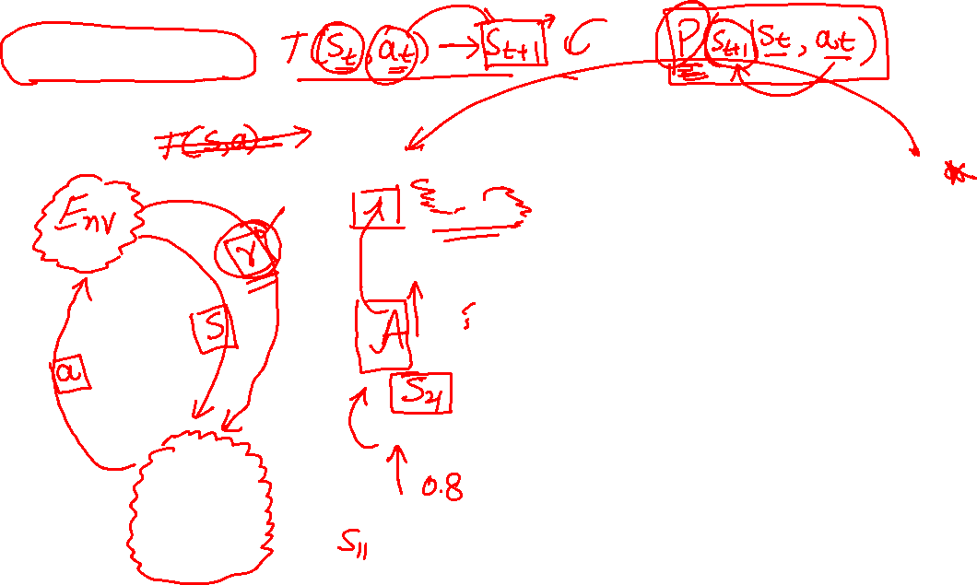
Stochastic Grid World

Slide 14
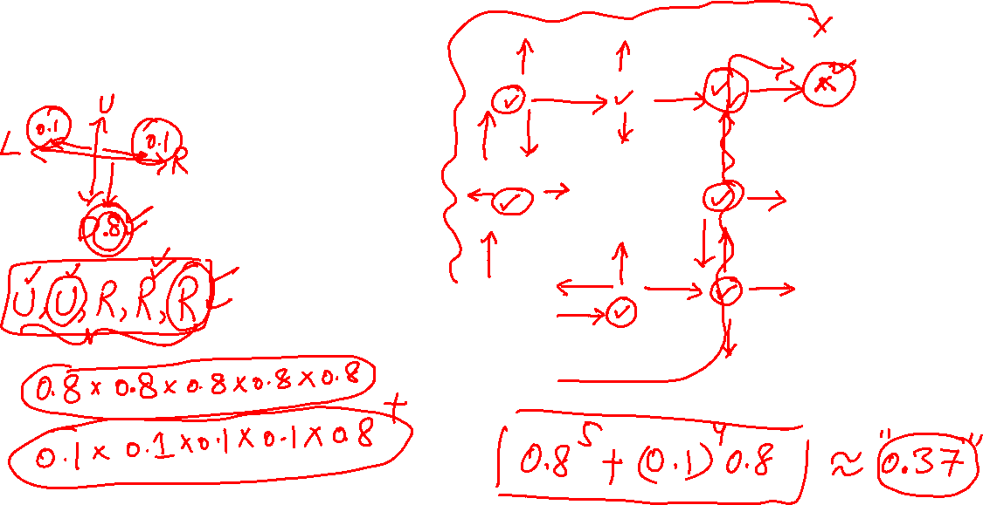
Stochastic Grid World

Slide 15
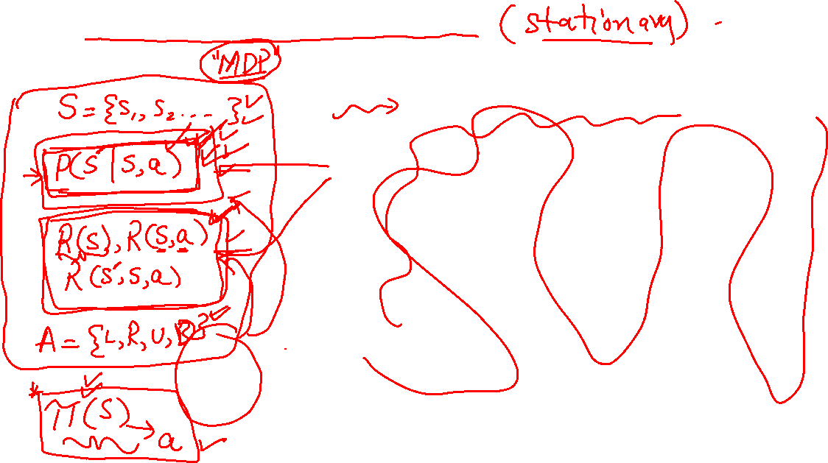
You don’t know the rules Grid World

Slide 16
Rules can change with time! Grid World

Slide 17
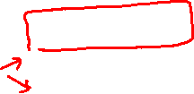
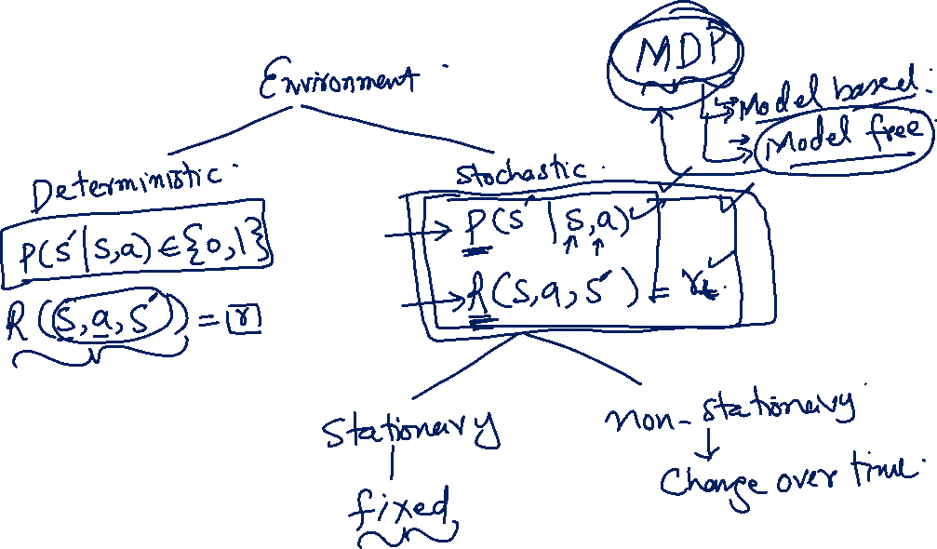
Summary RL Setups

Slide 18
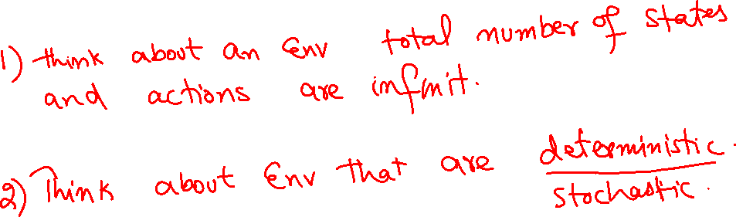
Exercise State and action spaces

Slide 19
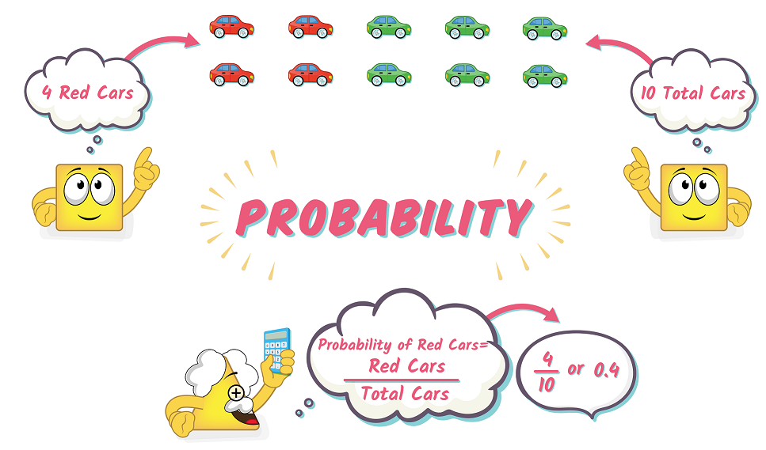
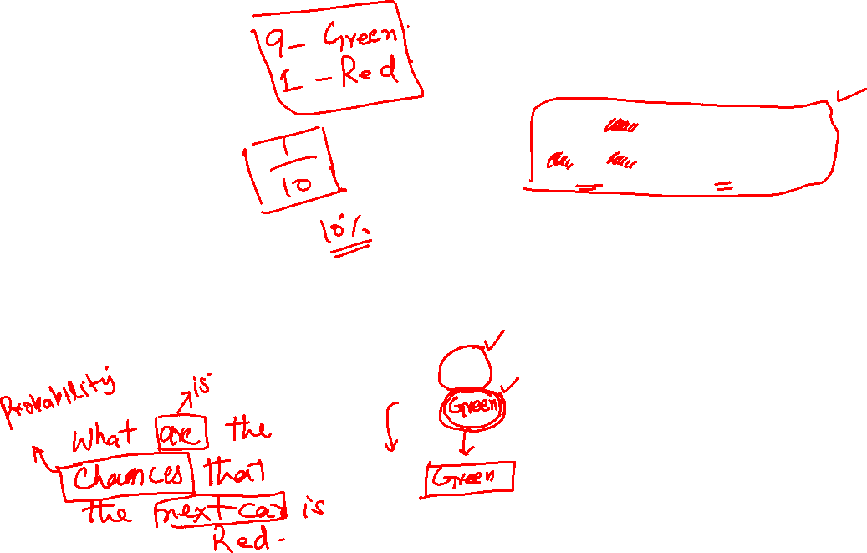
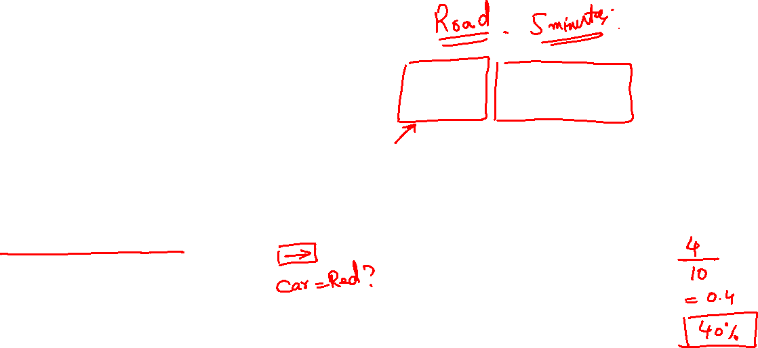
Probability
Courtesy: printrest.com

Slide 20
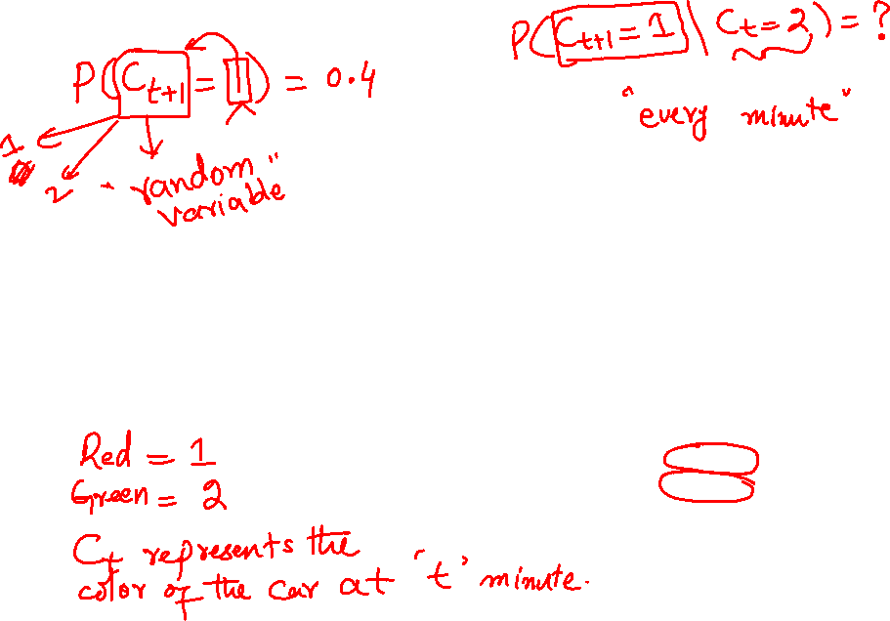
Probability
Courtesy: printrest.com

Slide 21
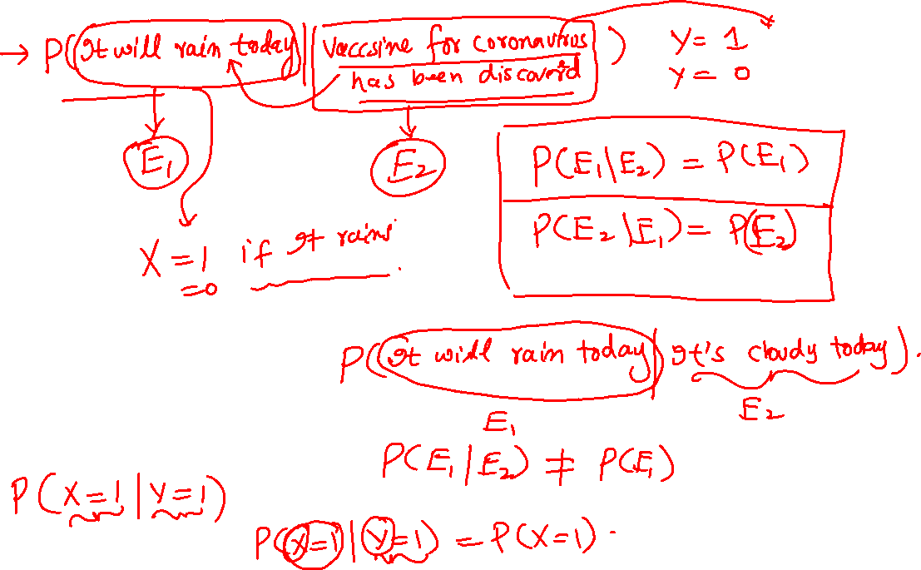
Conditional Probability

Slide 22
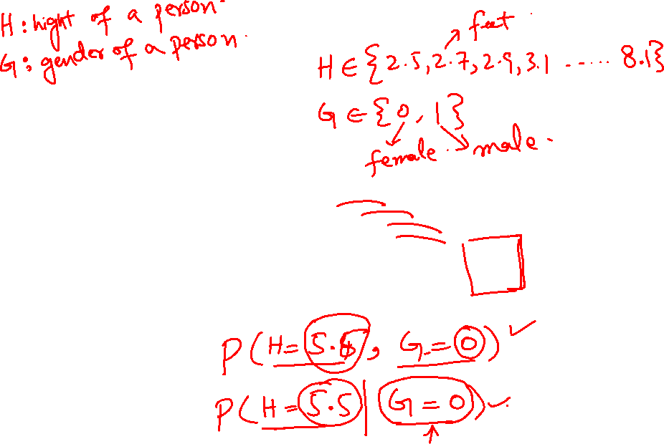
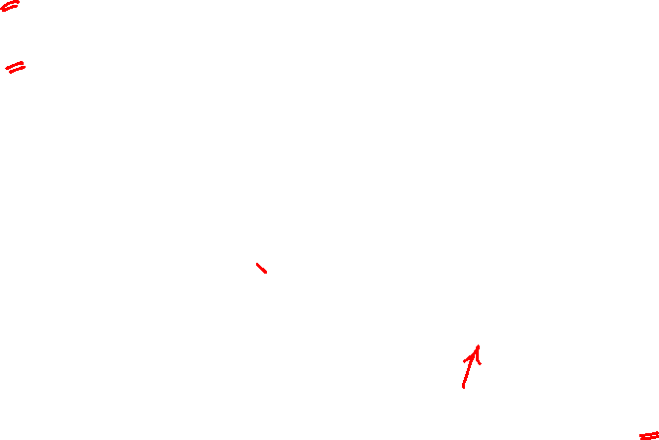
Joint Probability

Slide 23
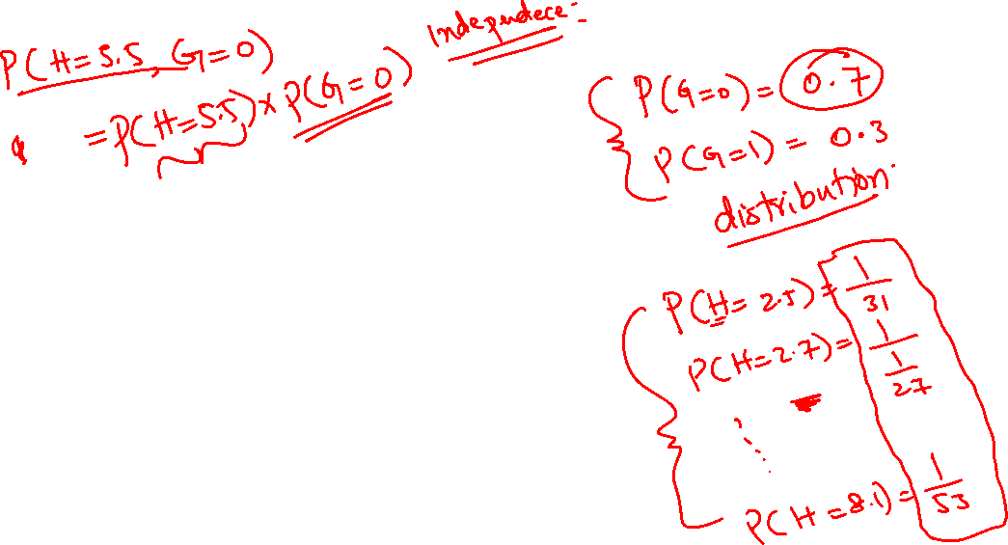
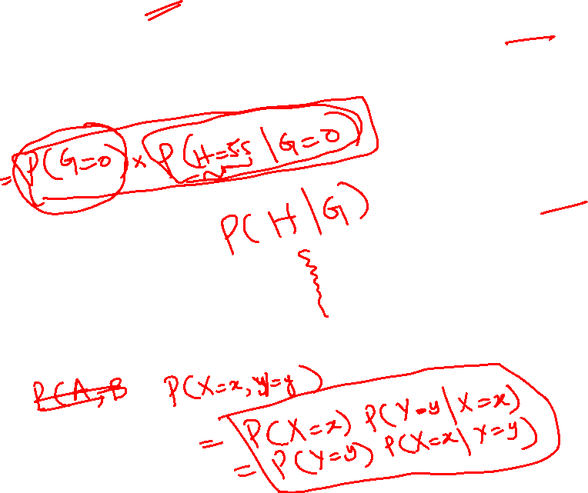
Joint Probability

Slide 24
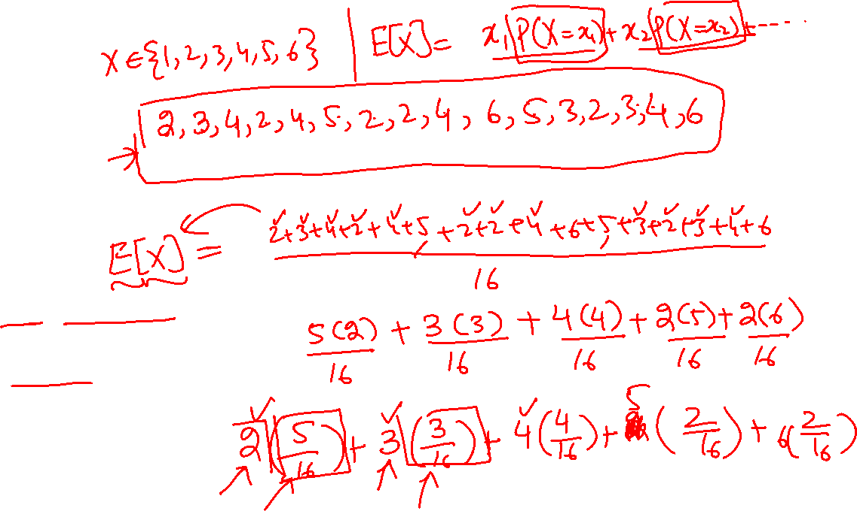
Expected Value

Slide 25
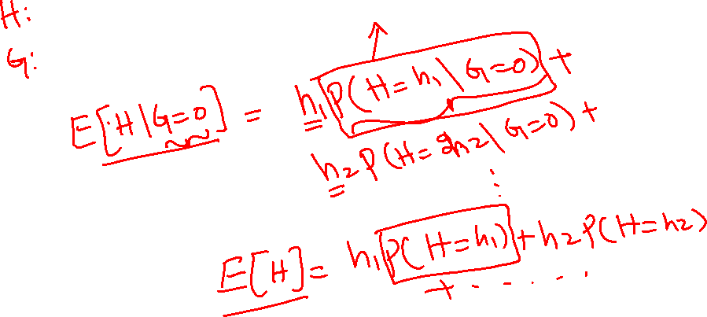
Conditional Expectation

Slide 26
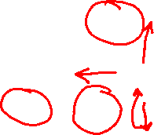
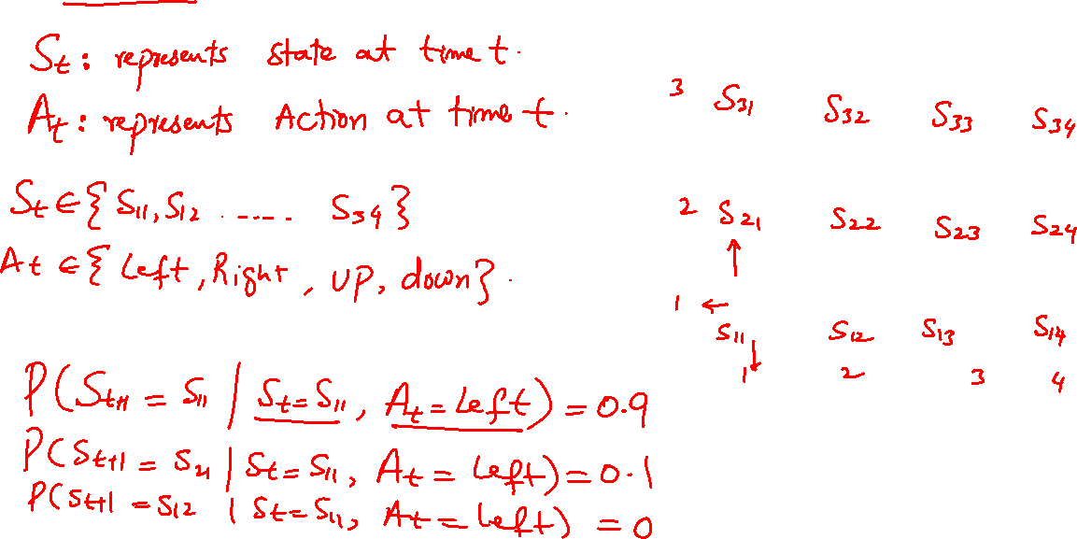
Modelling Uncertainty of Environment Grid World

Slide 27
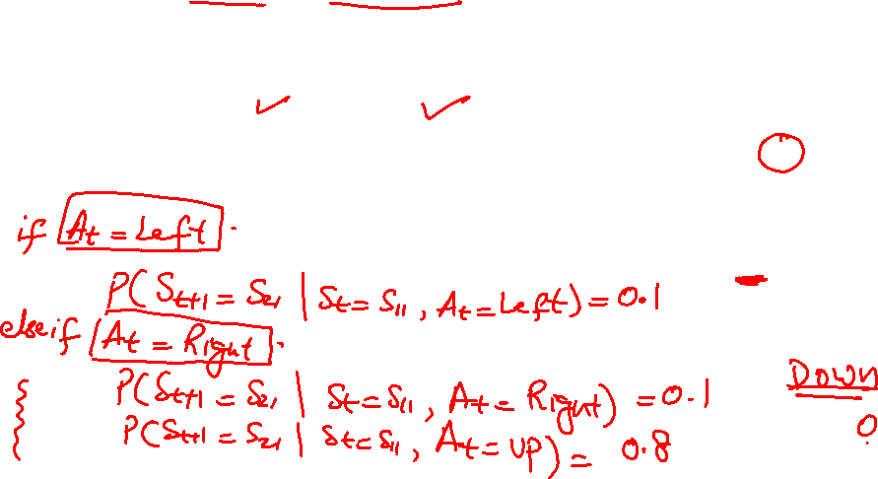
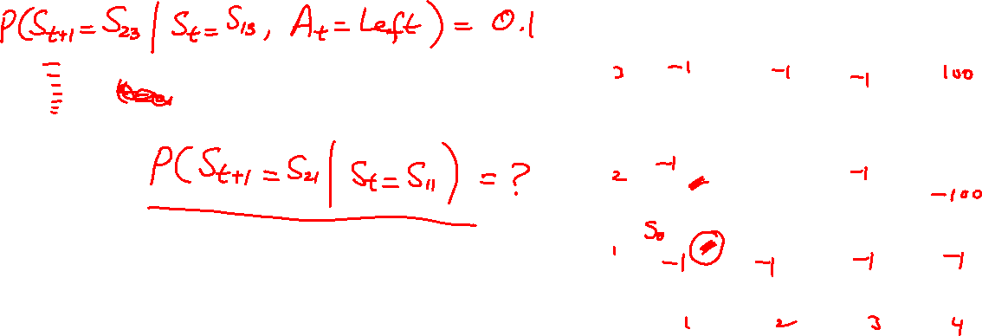
Modelling Uncertainty of Environment Grid World

Slide 28
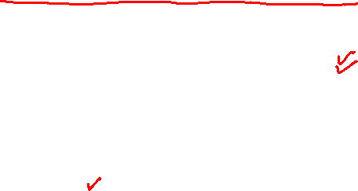
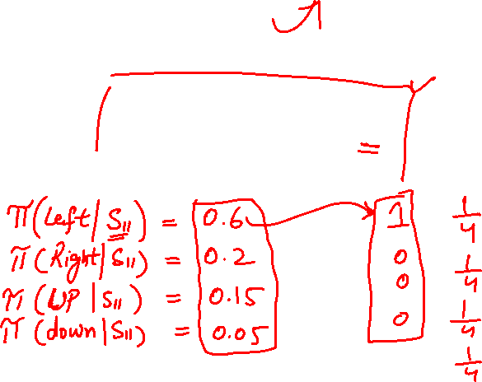
Modelling Uncertainty of Environment Grid World

Slide 29
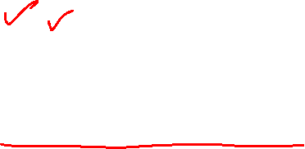
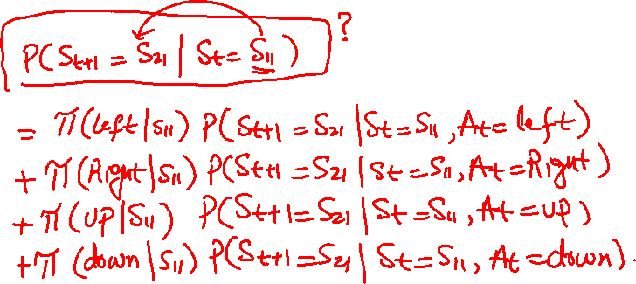
Modelling Uncertainty of Environment Grid World

Slide 30
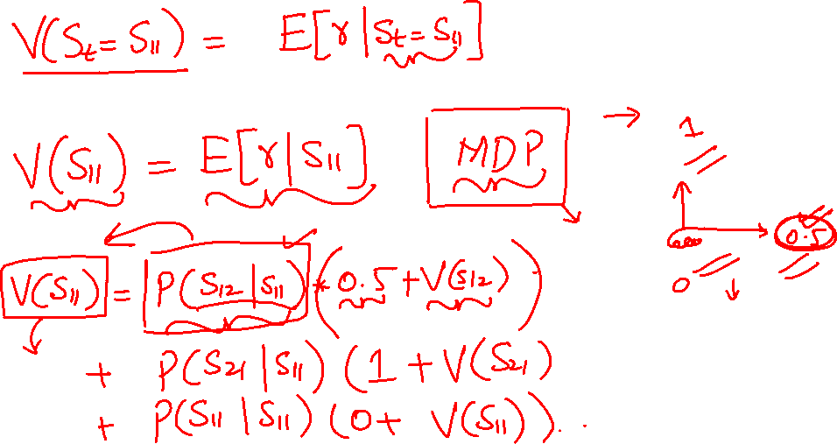
Modelling Uncertainty of Environment Grid World

Slide 31
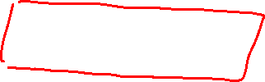
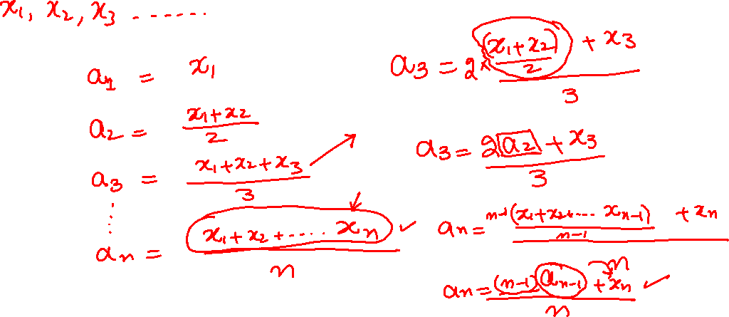
Running Averages Single Variable

Slide 32
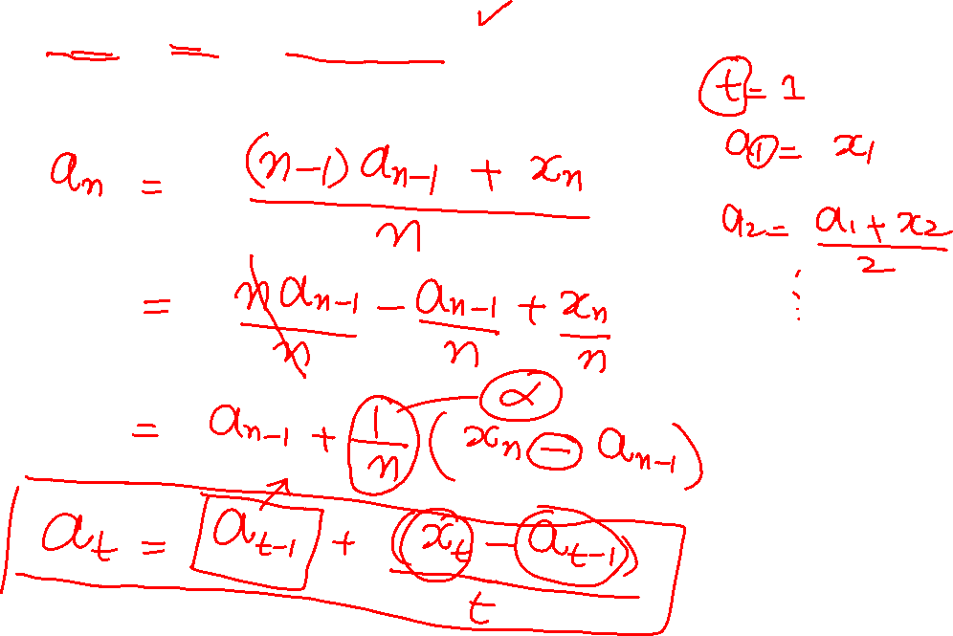
Temporal Difference Just a glimpse…

Slide 33
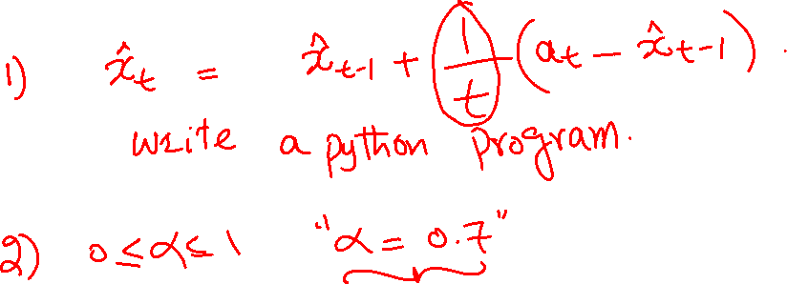
Exercise Running Averages

Slide 34
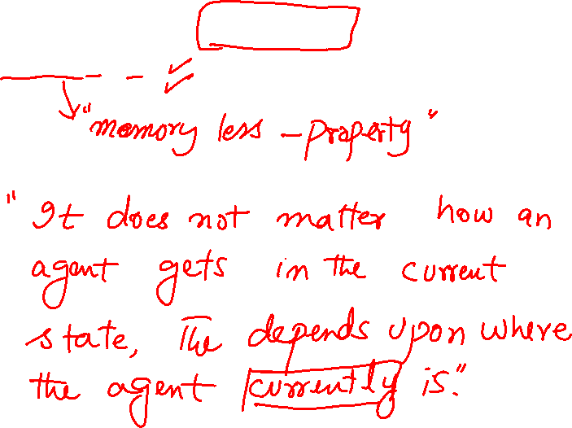
Elements of Markov Decision Process (MDP) Markov Property

Slide 35
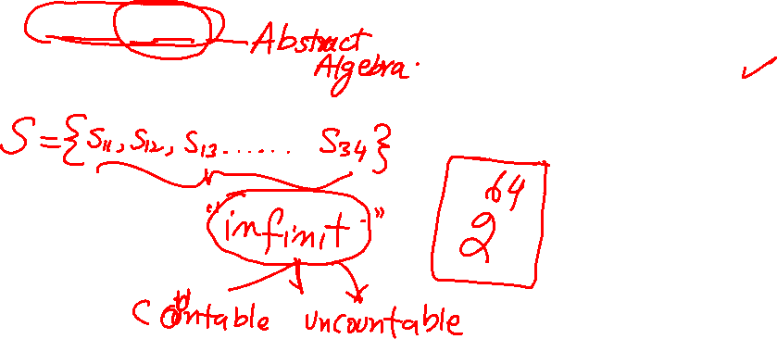
Elements of Markov Decision Process (MDP) State Space

Slide 36
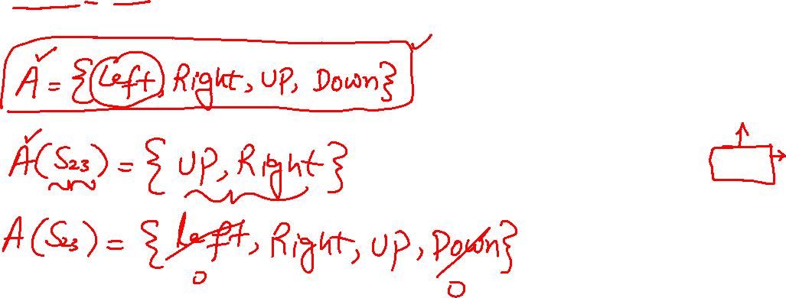
Elements of Markov Decision Process (MDP) Action Space

Slide 37
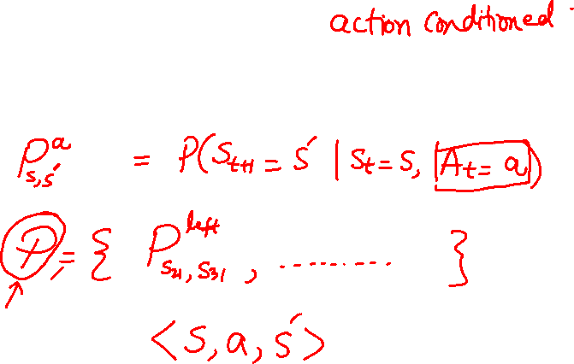
Elements of Markov Decision Process (MDP) Transition Probabilities

Slide 38
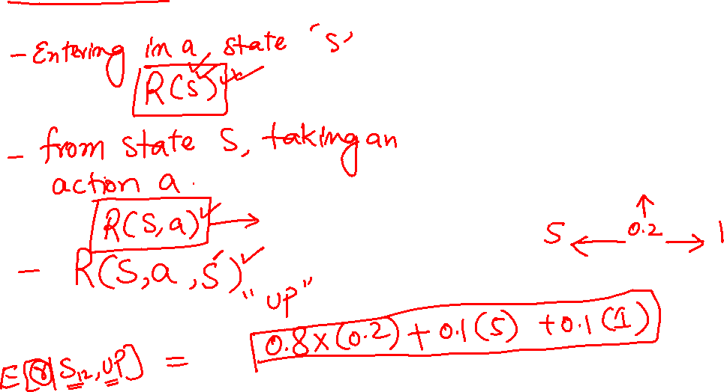
Elements of Markov Decision Process (MDP) Reward function

Slide 39
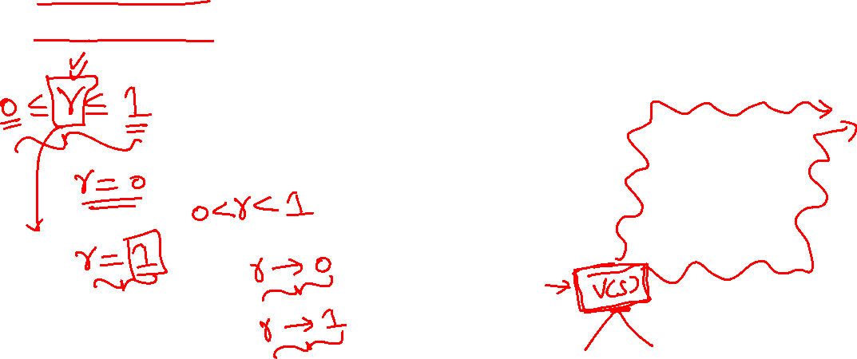
Elements of Markov Decision Process (MDP) Discount Factor

Slide 40
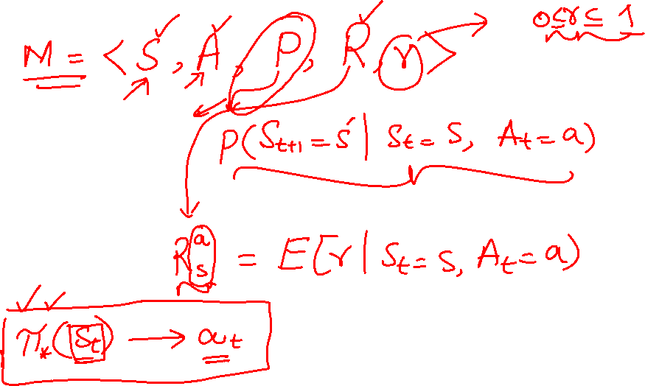
Markov Decision Process (MDP) Summary

Slide 41
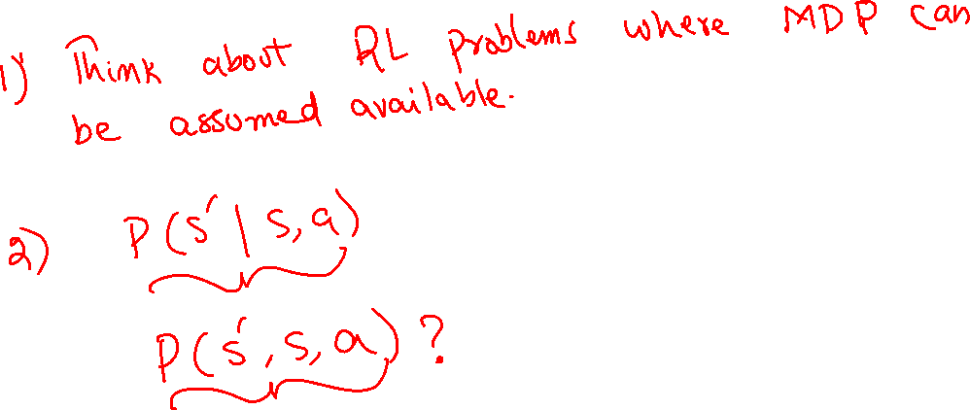
Exercise MDP

Slide 42
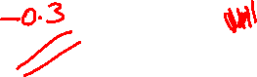

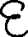
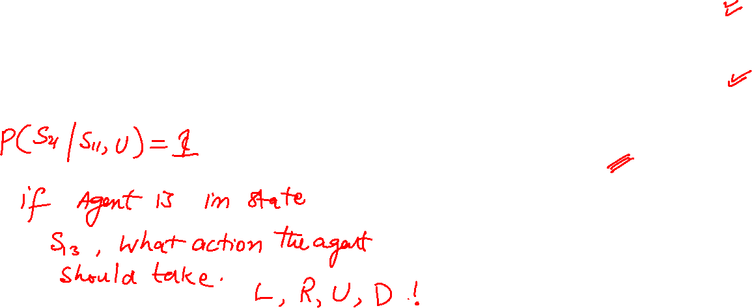
More on Rewards Delayed Reward

Slide 43
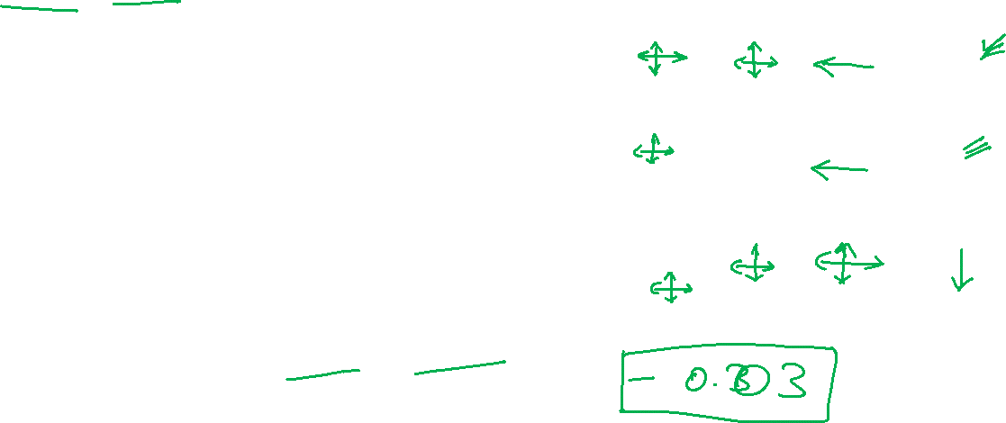

More on Rewards Reward Scaling

Slide 44

More on Rewards Reward Scaling

Slide 45

More on Rewards Infinite Horizons

Slide 46


More on Rewards Reward of a sequence

Slide 47
More on Rewards Reward of a sequence

Slide 48

Solving an MDP State Values

Slide 49

Solving an MDP Optimal Value function

Slide 50

Solving an MDP Optimal Policy

Slide 51

Solving an MDP Value Iteration

Slide 52

Solving an MDP Value Iteration

Slide 53

















Solving an MDP Value Iteration Quiz

Slide 54










Solving an MDP Value Iteration Solution

Slide 55

Solving an MDP Policy Evaluation

Slide 56

Solving an MDP Policy Evaluation

Slide 57


Solving an MDP Policy Evaluation

Slide 58

Solving an MDP Policy Evaluation

Slide 59

Solving an MDP Policy Iteration

Slide 60

Solving an MDP Policy Iteration

Slide 61


Solving an MDP Action Values

Slide 62

Solving an MDP Action Values

Slide 63


MDP is unknown?

Slide 64


MDP unknown Model based Solutions

Slide 65

MDP unknown Model based Solutions

Slide 66

MDP unknown Model Free Solution

Slide 67

Model Free Learning Monte-Carlo Learning Temporal-Difference Learning

Slide 68


Model Free Learning Monte-Carlo Learning

Slide 69

Model Free Learning Monte-Carlo Learning

Slide 70


Temporal Difference Learning (TD) Action Values

Slide 71

Temporal Difference Learning (TD) Action Values

Slide 72


Temporal Difference Learning (TD) Action Values

Slide 73

Temporal Difference Learning (TD) Algorithm

Slide 74

Temporal Difference Learning (TD) Exploration vs Exploitation

Slide 75

Temporal Difference Learning (TD) epsilon greedy policy

Slide 76

Temporal Difference Learning (TD) SARSA

Slide 77

Temporal Difference Learning (TD) SARSA

Slide 78

Temporal Difference Learning (TD) Q-Learning

Slide 79

Towards TD(λ) Multi-step look a head

Slide 80

Towards TD(λ) Multi-step look a head

Slide 81
Towards TD(λ) Multi-step look a head

Slide 82

Towards TD(λ) Multi-step look a head

Slide 83

Towards TD(λ) Eligibility Trace

Slide 84

Towards TD(λ) Q-Learning

Slide 85


Frozen Lake Q-Learning

